Slide 1
Homework 4
Simulation of Complex Systems
Francisco Caetano

Slide 2
Exercise 1
The Erdõs-Rényi random graph
Visualisation of the network (a graph plot)
Degree distribution plot

Slide 3
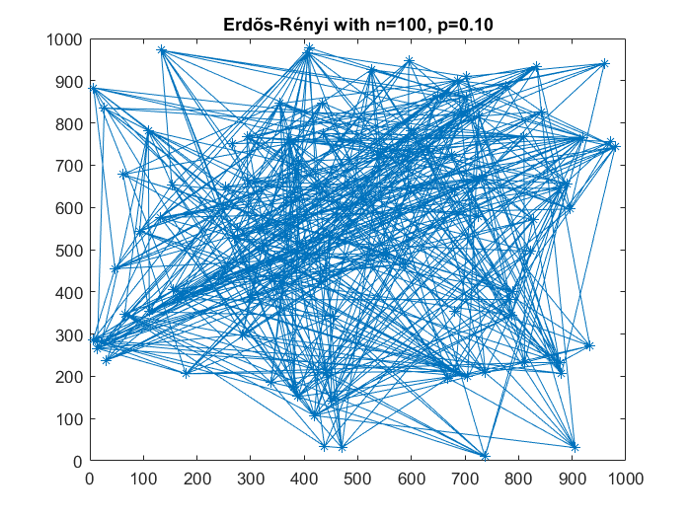
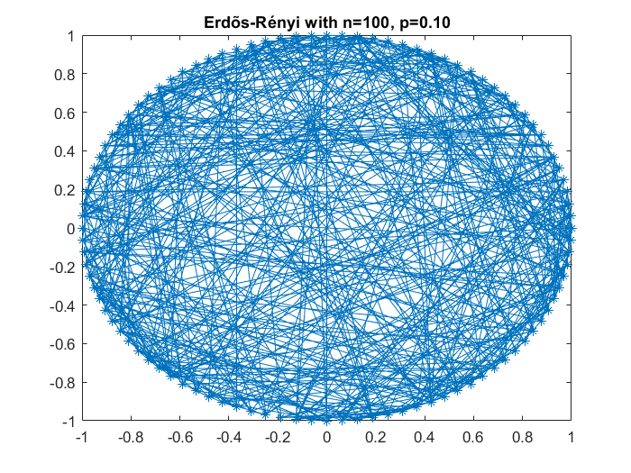
Network
Random Node location
Nodes positioned in a circle

Slide 4
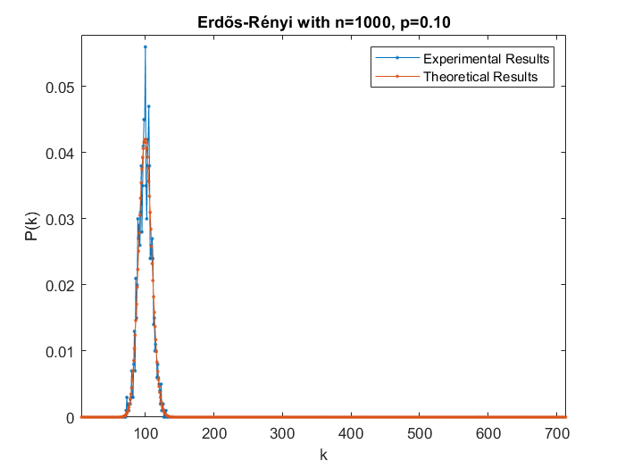
Degree Distribution

Slide 5
Exercise 2
The Watts-Strogatz small world model
Network before the shortcuts
Network after the shortcuts

Slide 6
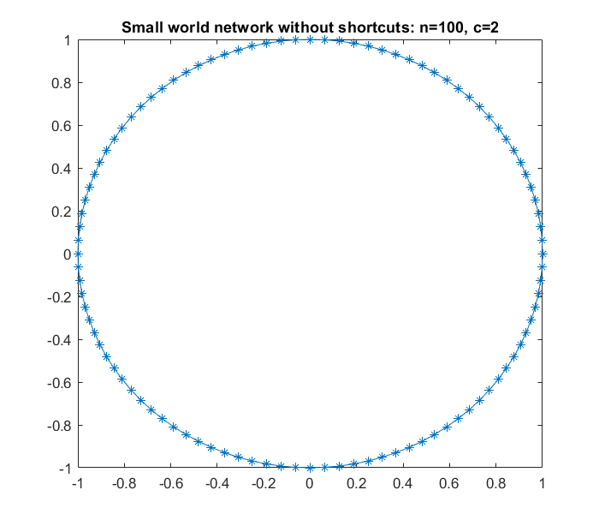
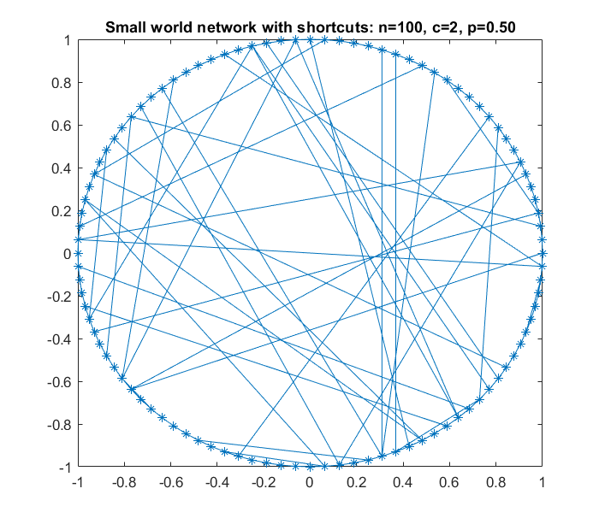
N=100
Without Shortcuts
With Shortcuts

Slide 7
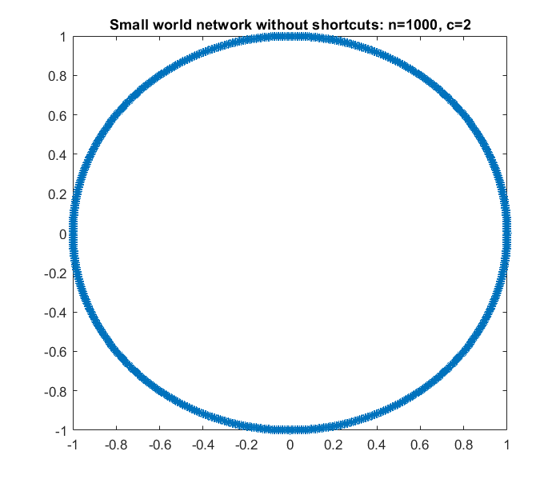
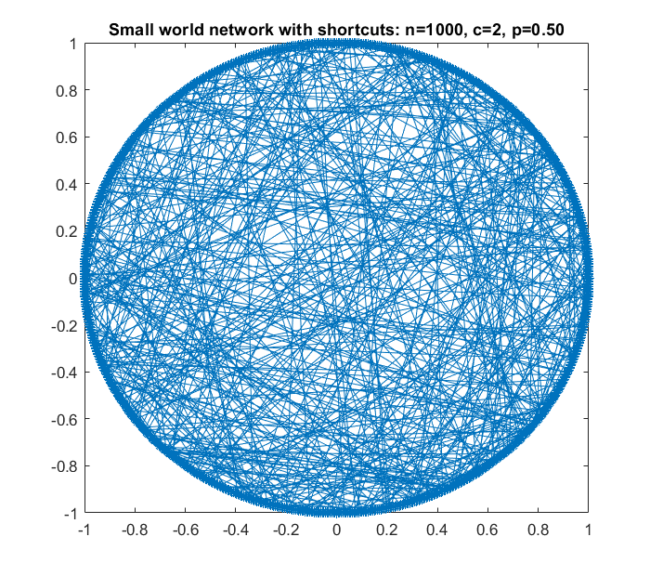
N=1000
Without Shortcuts
With Shortcuts

Slide 8
Exercise 3
The Albért-Barabási preferential growth model
Visualisation of the network
Power law plot

Slide 9
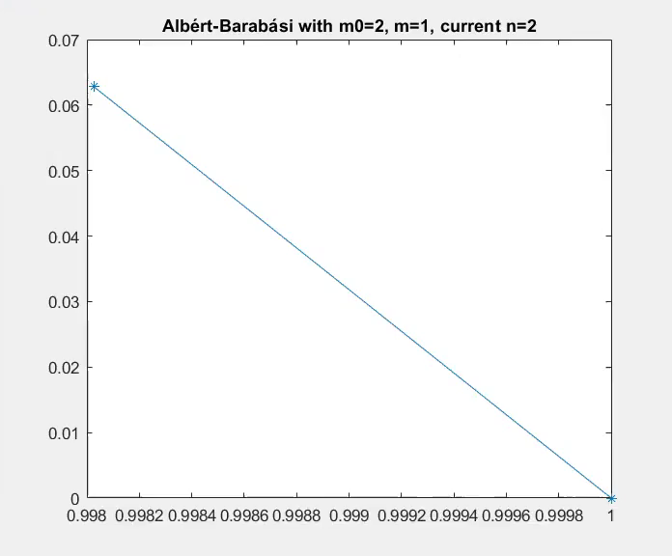
Network

Slide 10
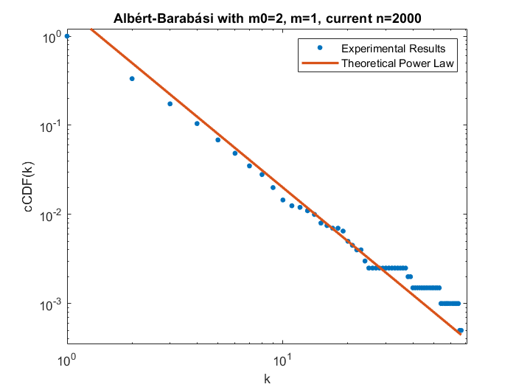
Power-law Plot

Slide 11
Exercise 4
A graph plot of the example network
The calculated clustering coefficient for the example graph
Code snippet showing the algorithm

Slide 12
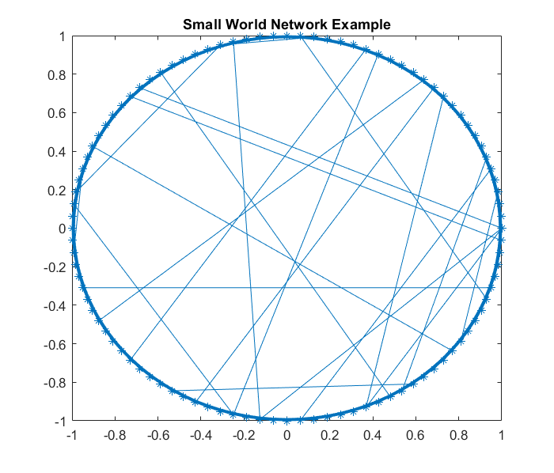
Network

Slide 13
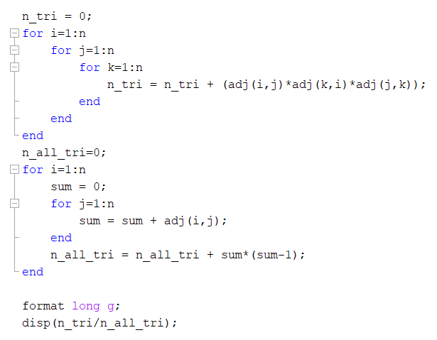
Code and Results
Clustering Coefficient = 0.611280

Slide 14
Exercise 5
The calculated average path length of the example graph
Code snippet showing the algorithm

Slide 15
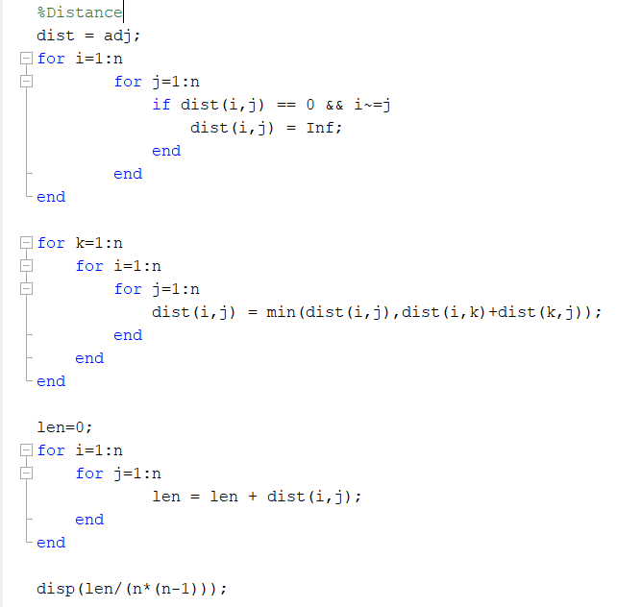
Code and Results
Average Path Length = 2.93232
Similar to Floyd–Warshall algorithm
https://www.youtube.com/watch?v=oNI0rf2P9gE&ab_channel=AbdulBari

Slide 16
Exercise 6
Calculated results and identification of each network, explained in terms of the results
Social network of email exchanges at a Spanish university
The Western States power grid
The (largest cluster of the) protein interaction network in yeast

Slide 17
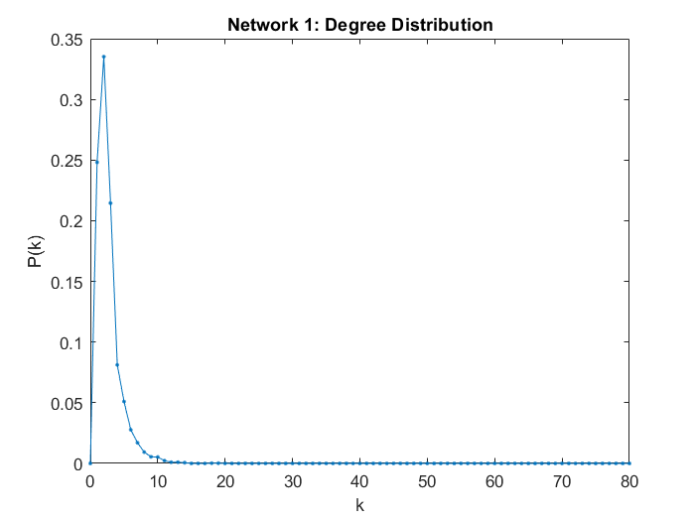
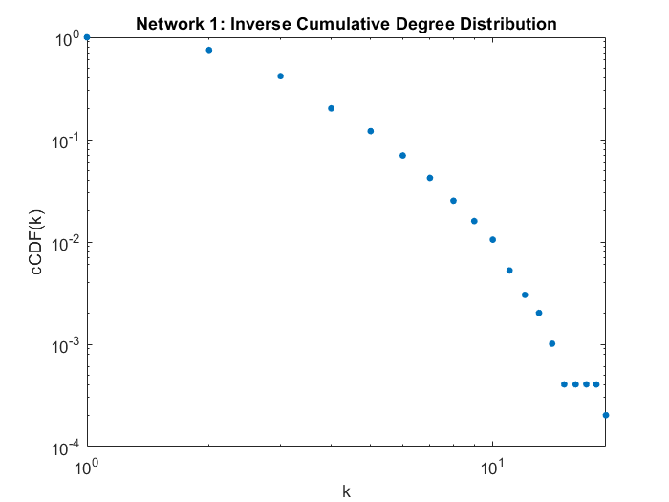
Network 1
Degree Distribution
Inverse cumulative degree distribution
Clustering Coefficient = 0.103153; Average Path Length = 18.989185; Diameter = 46

Slide 18
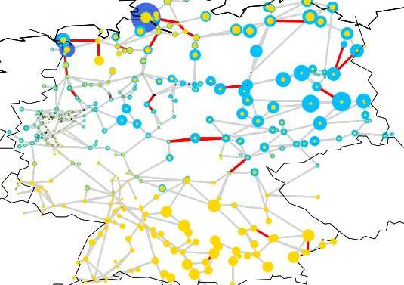
Network 1 = Power Grid
Power grids can be seen as radial networks.
The peripheral nodes have a small number of edges (and there are no shortcuts from one side to the other)
Therefore, the average path length and diameter are high for these networks, as we verified for this case.
Example of a power grid network

Slide 19
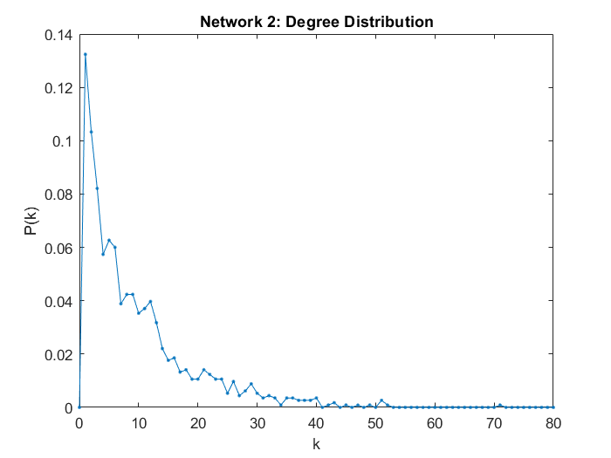
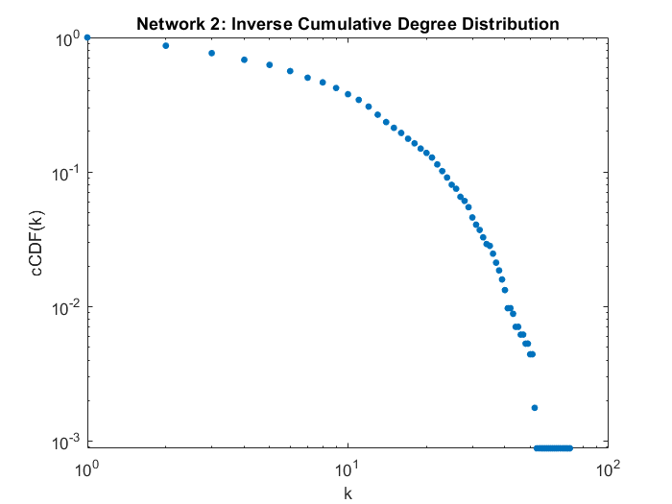
Network 2
Degree Distribution
Inverse cumulative degree distribution
Clustering Coefficient = 0.166269; Average Path Length = 3.606033; Diameter = 8

Slide 20
Network 2 = Social Network
In social networks, nodes tend to create tightly knit groups characterised by a relatively high density of ties
As expected, this network has the highest clustering coefficient of the three networks
It also has a low average path length as well as a low diameter.

Slide 21
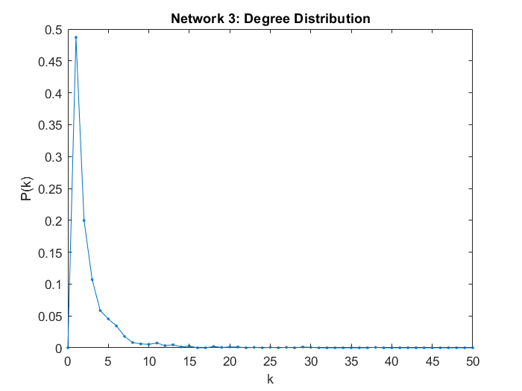
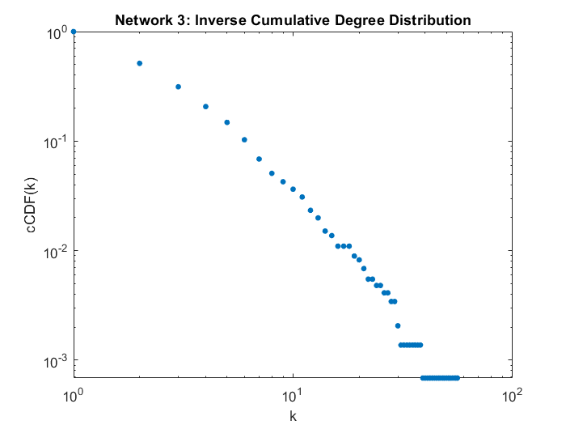
Network 3
Degree Distribution
Inverse cumulative degree distribution
Clustering Coefficient = 0.0793696; Average Path Length = 6.812387; Diameter = 19

Slide 22
Network 3 = Protein-Protein Interaction
It is a scale free network.
Scale-free networks can be built following the preferential attachment model.
The inverse cumulative degree distribution clearly shows that the degree distribution fits a power law
The average path length is also relatively small as expected

